Slide 2
IBM Data Science Capstone Toronto for tourism
By : ZAHRA ZANDESH

Slide 3
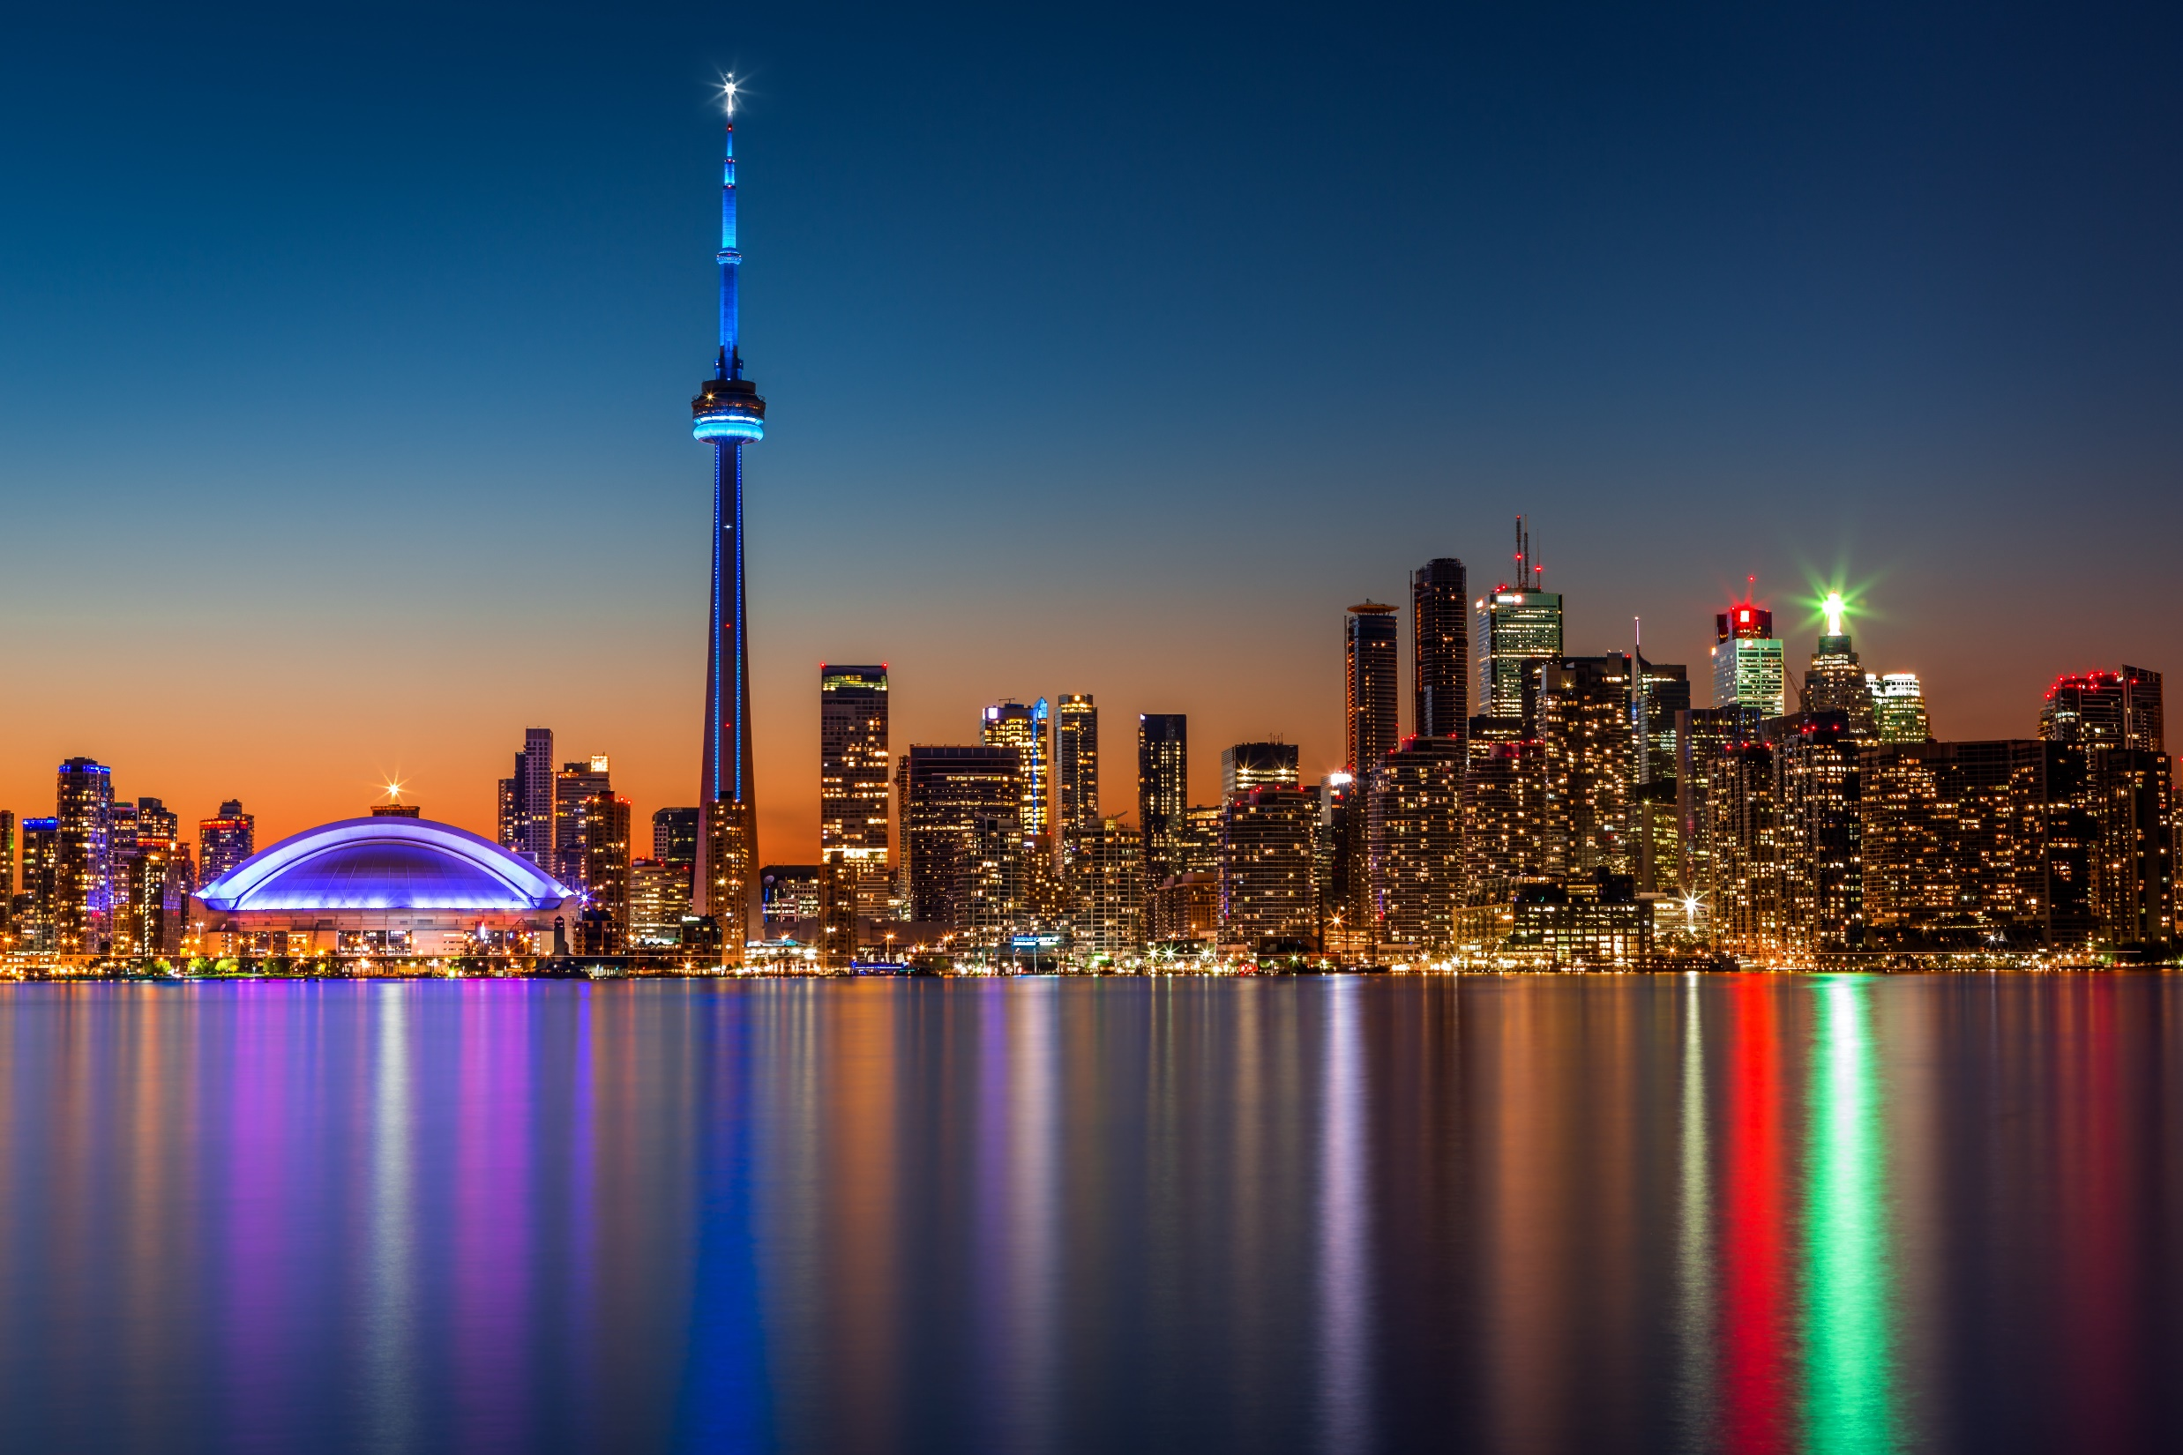

Slide 4
Toronto
Toronto is the capital city of the Canadian province of Ontario.
Toronto is a prominent centre for music, theatre ,motion picture production, and television production,[and is home to the headquarters of Canada's major national broadcast networks and media outlets. Its varied cultural institutions, which include numerous museums and galleries, festivals and public events, entertainment districts, national historic sites, and sports activities, attract over 43 million tourists each year. Toronto is known for its many skyscrapers and high-rise buildings, in particular the tallest free-standing structure in the Western Hemisphere, the CN .
The city is home to the Toronto Stock Exchange, the headquarters of Canada's five largest banks, and the headquarters of many large Canadian and multinational corporations. Its economy is highly diversified with strengths in technology, design, financial services, life sciences, education, arts, fashion, aerospace, environmental innovation, food services, and tourism.

Slide 5
ABOUT TOURISM TORONTO
Tourism Toronto is the official destination marketing organization for the region, "Canada's Downtown" encompassing Toronto, Mississauga and Brampton. With sales and marketing programs in key markets around the world, Tourism Toronto promotes the Toronto region as a remarkable destination for tourists, convention delegates and business travelers.

Slide 6
ABOUT TOURISM TORONTO
Toronto has a diverse array of public spaces, from city squares to public parks overlooking ravines. Nathan Phillips Square is the city's main square in downtown, contains the 3D Toronto sign, and forms the entrance to City Hall. Yonge–Dundas Square, near City Hall, has also gained attention in recent years as one of the busiest gathering spots in the city.

Slide 7
Business problem
Problem:
Tourism company is looking to expand the visit-able and suitable places for tourists
Outcome :
Provide information and recommendation for an informed decision where they could find their destinations

Slide 8
The Questions which I aim to answer in this project are the following:
We should Find
The borough names containing Toronto
The number off borough names containing Toronto
Most common venues in Toronto.
Tourism halls in Toronto.

Slide 9
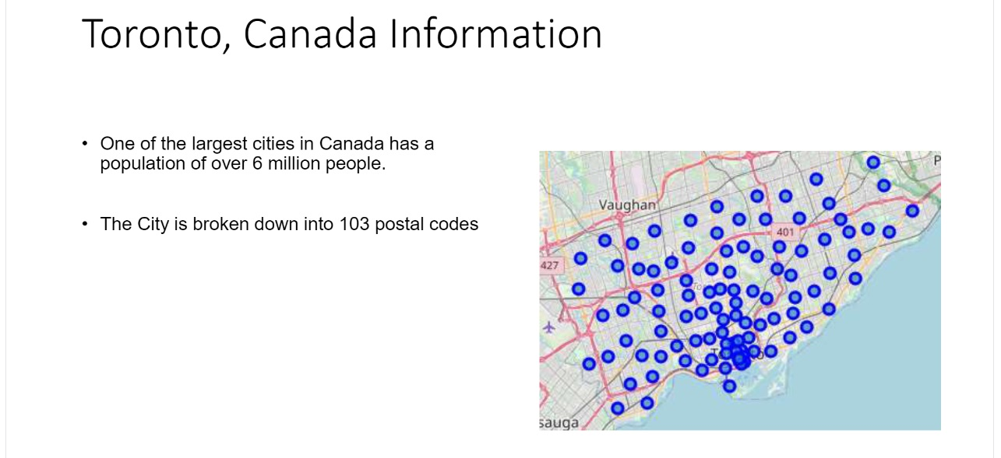

Slide 10
Methodology
First, we scrape the data using BeautifulSoup.
Second, we find the latitudes and longitudes of the given addresses(using Gmaps geocoding API)
Third, we will plot those coordinates using the folium map.
Fourth, We will find the number of collisions in the given dataset.
Fifth, Using the dataset, we will use FourSquare API for finding the places resided near to those pin codes and merge with the original dataset
Sixth, To use this dataset for predicting the most common venue, we have to use one-hot encoding for K-means Clustering algorithm.
Seventh, Using the silhouette score, we will find the best K-value for our most common venue prediction.
At last, Using the K-value, we will find the cluster labels for each an every place and last we will plot the map and find the most common venue point in the selective district.

Slide 11
Data source
For the Toronto data, a Wikipedia page exists that has all the information
we need to explore and cluster the neighborhoods in Toronto.
segment, and cluster the neighborhoods in the city of Toronto based on the postal code and borough information.

Slide 12
Result: Number of Boroughs and Neighborhoods
The data frame has 15 boroughs and 103 neighborhoods

Slide 13
Result: Borough names containing Toronto
Postal code | Borough | Neighborhood
M5A | Downtown Toronto | Regent Park, Harbourfront
M5B | Downtown Toronto | Garden District, Ryerson
M5C | Downtown Toronto | St. James Town
M4E | East Toronto | The Beaches
M5E | Downtown Toronto | Berczy Park

Slide 14
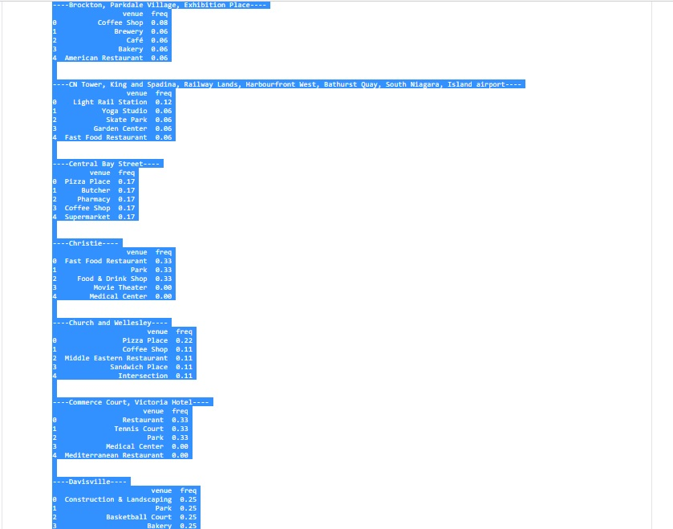
Result: Most common venues in Toronto.

Slide 15
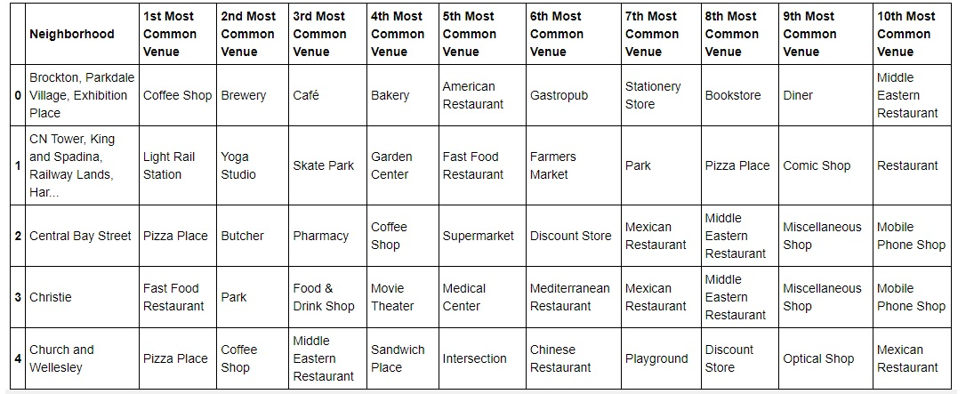
Result: Tourism halls in Toronto.

Slide 16
Discussion/
15 boroughs has found with Toronto name
From mapping done ,Toronto has several existing general and entertainment Venus like :Coffee Shop ,Brewery ,Café ,Bakery ,American Restaurant, Light Rail Station, Yoga Studio, Skate Park, Garden Center ,Fast Food, Restaurant ,Pizza Place, Butcher ,Pharmacy, Supermarket, Park , Food & Drink Shop ,Movie Theater ,Medical Center ,Middle Eastern Restaurant , Sandwich Place ,Intersection ,Tennis Court ,Mediterranean Restaurant ,Construction & Landscaping , Basketball Court , Vietnamese Restaurant , Vegetarian / Vegan Restaurant , Grocery Store, Shopping Mall , Bank ,Monument / Landmark , Mobile Phone Shop , Sandwich Place, Gym , Thrift / Vintage Store , Burrito Place , Baseball Field ,Airport Service ,Airport Terminal , Airport , Bar ,Skating Rink , Farm , College Stadium , General Entertainment ,Athletics & Sports , Spa , Beer Store , Bus Stop ,Italian Restaurant , Hotel , Gym , Cocktail Bar ,Dessert Shop ,Sushi Restaurant , Pub , Health Food Store , Trail ,Breakfast Spot , Gift Shop , Bookstore ,Field , Hockey Arena , Lounge , Grocery Store Candy Store Baby Store , Rental Car Location, Electronics Store , Donut Shop ,Construction & Landscaping, Pool ,Indian Restaurant , Museum ,Convenience Store , Bus Line ,Burger Joint, Mexican Restaurant ,Clothing Store , Cosmetics Shop , Women's Store, Chinese Restaurant , Japanese Restaurant ,Gastropub ,Pet Store ,Greek Restaurant , Burrito Place, Ice Cream Shop , Italian Restaurant , Furniture / Home Store, Discount Store , Turkish Restaurant

Slide 17
Conclusion
Restaurant / fast food /coffee shops can find in each tourism hall .
Informing about Venus distribution help tourism industry /company ,guide to manage their time, cost, recourses.
Some neighbors like :
Can play tourism hall role which are hub for most of places.

Slide 18
Thank You
Zahra Zandesh

